Slide 1
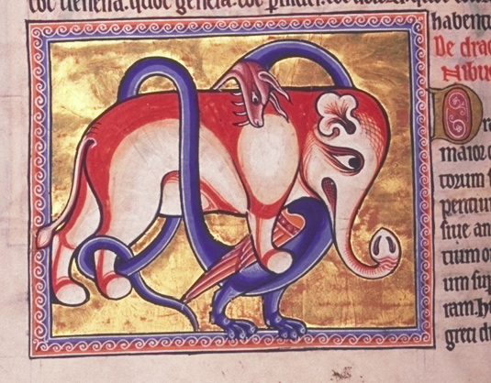
A Brief History of the Bestiary

Slide 2
-More information on / discussion of who interacted with these works, and how. -Group work on difficult texts? -Summaries for works with difficult language particularly helpful. "It's too easy to not participate." -Almost no one requested MORE time on translation (although one or two did – pronunciation?). -Post PowerPoints online? -Worst thing about the course: "that room."

Slide 3
Quick Facts on the Physiologus: -Originally written in Greek, most probably in Alexandria, Egypt between the second and fifth centuries A.D. -"Physiologus" was understood to be name of the (unknown) author: "the Physiologer." -"Perhaps no book, except the Bible, has ever been so widely diffused among so many people and for so many centuries as the Physiologus. It has been translated into Latin, Ethiopic, Arabic, Armenian, Syriac, Anglo-Saxon, Icelandic, Spanish, Italian, Provencal and all the principal dialects of the Germanic and Romanic languages." --E. P. Evans, Animal Symbolism in Ecclesiastical Architecture -Fantastical creatures make up less than 10% of the content of most bestiaries based on the Physiologus.

Slide 4
The Medieval European Bestiary: -Translations of the Physiologus continued to circulate during the late Middle Ages, but more popular were the very, very numerous Latin and vernacular bestiaries, most ultimately based on its collection of animals and moralities, but which often doubled or tripled the total number of entries. -Just as the Physiologus itself had absorbed many traditions of natural history (from Aristotle, Pliny the Elder, and others), later medieval bestiaries freely incorporate animal lore from various other sources, including Isidore's Etymologies (7th century A.D.). -The Latin bestiary that T.H. White translates as The Book of Beasts dates from the 12th century, still two centuries before Chaucer and long before the Middle English translation of the Physiologus (an Old English translation of 3 entries from the Physiologus does survive).

Slide 5
How to Read the Bible in the Middle Ages
Biblical commentators in the medieval West often employed a fourfold strategy of exegesis, understanding the meaning of the Scriptures on four (non-hierarchically organized) levels or "senses":
The literal or historical sense:
This sense encompasses what the text literally states: e.g., it is a historical truth that the Israelites fled slavery in Egypt under the leadership of Moses. Analysis or commentary on the "literal" sense of a Biblical passage also included commentary on matters related to the "letters," that is, questions of style, rhetoric, and language.
The allegorical or typological sense:
This sense perceives a deeper symbolic meaning in events
represented in the Bible, and most commonly matches a person or
event from the Old Testament with the event in the life of Christ that
it presages. The Exodus from Egypt understood in this sense
represents our collective salvation through Jesus and rescue from the
bondage of death. For another example, Jonah's 3 days in the belly of
the whale prefigure the 3 days Christ spent dead before his
resurrection.

Slide 6
How to Read the Bible in the Middle Ages
The moral or tropological sense:
This sense teaches good Christians how they should behave. To use
the example of the Exodus once again, in the moral sense this story of
a literal escape from slavery teaches us that we must strive in our
souls to escape the bondage of sin and strive for the freedom and
goodness we find in the grace of God.
4) The anagogical or mystical sense:
This sense may sometimes encompass a number of different abstract mystical implications of a Biblical passage, but most commonly turns our minds to the End Times and the final fate of the Earth and the souls of its human inhabitants. The anagogical reading of the Exodus understands it as a reflection of how the immortal soul will finally escape from the bondage of its temporary home on Earth and live everlastingly after the Last Judgment.

Slide 7
How to Read the Book of Nature in the Middle Ages
The Church Father Origen writes:
"The apostle Paul teaches us that us that the invisible things of God may be known through the visible, and things which are not seen may be contemplated by reason of and likeness to those things which are seen. He shows by this that this visible world may teach about the invisible and that earth may contain certain patterns of things heavenly, so that we may rise from lower to higher things, and out of those we see on earth perceive and know those which are in the heavens."
"Physiologus, to be sure, also elicits purely moral lessons from the natural world but more often aims at making manifest the nature of God himself by unveiling the vestiges of the Creator in creation. This is the justification for a Christian physiology."
--Michael J. Curley, Introduction to his translation of the Latin Physiologus

Slide 8
White's Bestiary Manuscript
Shelf mark: Cambridge University Library, MS Ii. 4. 26
Produced: England, 1200-10
Language: Latin
http://bestiary.ca/manuscripts/manu945.htm
Also: 'De Herinacio. On the Hedgehog' the first nature video based on medieval bestiary ('the Rochester Bestiary', British Library, Royal 12 F XIII). In Latin with English subs.
http://vimeo.com/97158950

Slide 9
Lion
Tiger
Pard / Leo-pard
Panther
Antelope
Unicorn
Lynx
Griffin
Elephant
Beaver
Ibex / Chamois
Hyena
Bonnacon (Bison?)
Monkey
Satyr
Stag
Mountain Goat
Monoceros (Unicorn-2?)
Bear
Leucrota (Manticore-2?)
Crocodile
Manticore
Parandrus (Reindeer?)
Fox
Yale (Gnu?)
Wolf
[Moralization]
Sheep, assorted
He-Goat
Wild Boar
Ox
Camel
Donkey / Onager
Horse
Cat
Mouse
Weasel
Hedgehog
Mole
Ant

Slide 10
"The monkey represents the very person of the devil since he has a beginning but no end (that is, a tail). In the beginning, the devil was one of the archangels, but his end has not been found. It is fitting also that, in addition to not having a tail, the monkey lacks beauty also. And he is quite ugly in that region where he lacks a tail. Just so the devil has no good end. Physiologus, therefore, spoke well."
--The Latin Physiologus

Slide 11
And als the caus quhy that thay first began Wes to repreif thee of thi misleving, O man, be figure of ane uther thing (Henryson, Fables 5-8)
The nuttis schell thocht it be hard and teuch Haldis the kirnell sweit and delectabill, Sa lyis thair ane doctrine wyse aneuch And full of frute under ane fenyeit fabill, And clerkis sayis it is richt profitabill Amangis ernist to ming ane merie sport To blyth the spreit and gar the tyme be schort. (15-21)
But ye that holden this tale a folye,
As of a fox, or of a cok and hen,
Taketh the moralite, goode men.
For Seint Paul seith that al that writen is,
To oure doctrine it is ywrite, ywis;
Taketh the fruyt, and lat the chaf be stille.
(Nun's Priest's Tale 3438-3443)

Slide 12
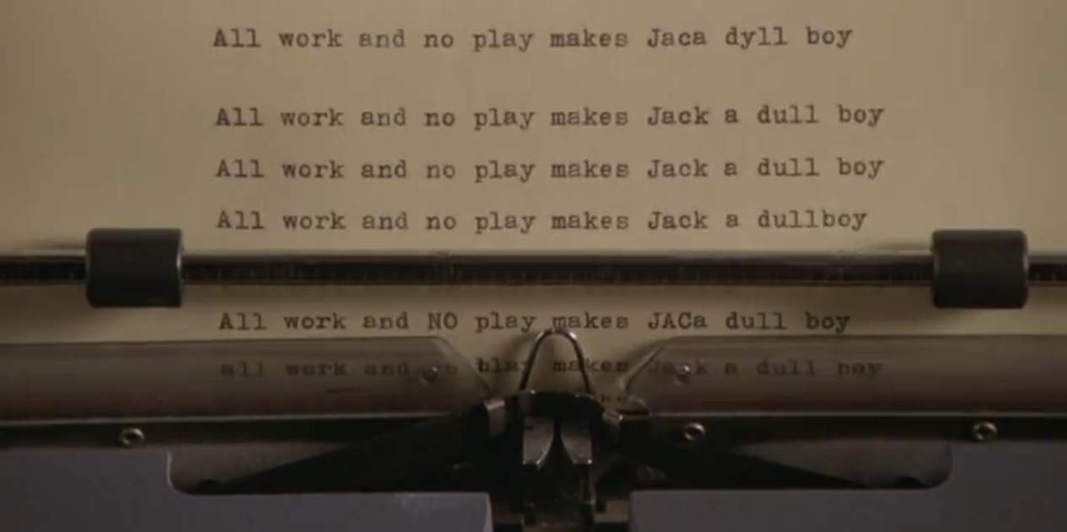
For as we se, ane bow that ay is bent Worthis unsmart and dullis on the string Sa dois the mynd that ay is diligent In ernistfull thochtis and in studying. With sad materis sum merines to ming (22-26)

Slide 13
My author in his fabillis tellis how That brutal beistis spak and understude And to gude purpois dispute and argow, Ane sillogisme propone and eik conclude, Puttyng exempill and similitude How mony men in operatioun Ar like to beistis in conditioun. Na mervell is ane man be lyke ane beist Quhilk lufis ay carnall and foull delyte That schame cannot him renye nor arreist Bot takis all the lust and appetyte Quhilk throw custum and the daylie ryte Syne in the mynd sa fast is radicate That he in brutal beist is transformate. (43-56)

Slide 14
The Cock and the Fox Thocht brutall beistis be irrationall, That is to say, wantand discretioun, Yit ilkane in thair kyndis naturall Hes mony divers inclinatioun: The bair busteous, the wolf, the wylde lyoun, The fox fenyeit, craftie, and cautelows, The dog to bark on nicht and keip the hows. Sa different thay ar in properteis Unknawin unto man and infinite, In kynd havand sa fell diversiteis, My cunning it excedis for to dyte. (397-407)

Slide 15
To this day, the state flag of Louisiana reflects the biology of the Pelican
Proposed in the ancient and medieval bestiary tradition.

