Slide 1
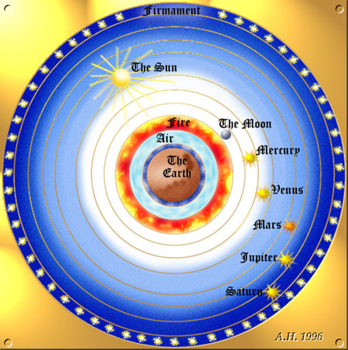

Slide 2
And whan that he [Troilus] was slayn in this manere [that is, by Achilles], His lighte goost ful blisfully is went Up to the holughnesse of the eighthe spere, In convers (converse/opposite side) letyng ("letting" i.e. abandoning) everich element; And ther he saugh with ful avysement (deliberation, consideration) The erratik sterres, herkenyng armonye With sownes ful of hevenyssh melodie. And down from thennes faste he gan avyse (see, consider) This litel spot of erthe that with the se Embraced is, and fully gan despise This wrecched world, and held al vanite To respect of the pleyn felicite That is in hevene above; and at the laste, Ther he was slayn his lokyng down he caste, And in hymself he lough right at the wo Of hem that wepten for his deth so faste, And dampned al oure werk that foloweth so The blynde lust, the which that may nat laste, And sholden al oure herte on heven caste; And forth he wente, shortly for to telle, Ther as Mercurye sorted hym to dwelle. --Chaucer, Troilus and Criseyde Book V.1807-1827)

Slide 3
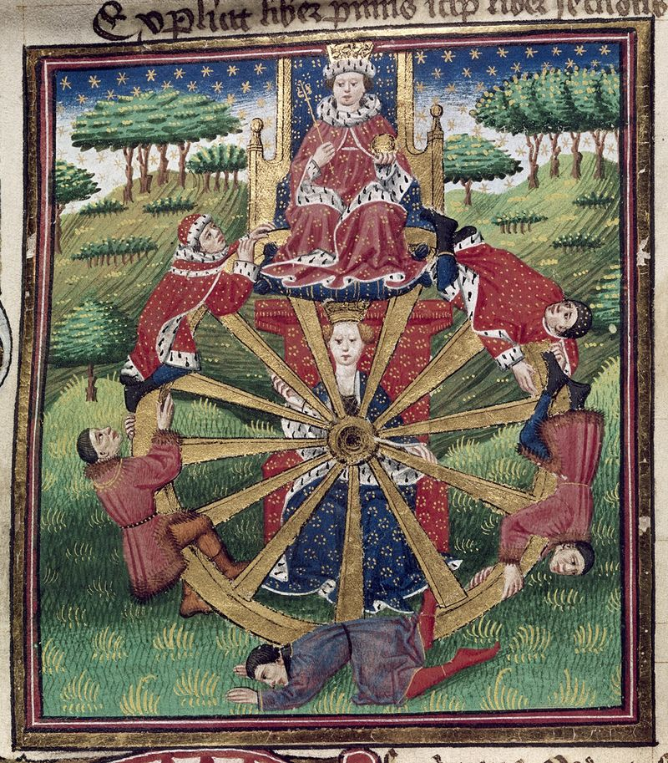
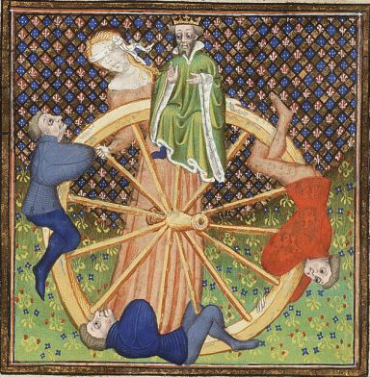

Slide 5
For out of olde feeldes, as men saith,
Cometh al this newe corn from yeer to yere;
And out of olde bookes, in good faith,
Cometh al this newe science that men lere.

Slide 6
Some Big Questions: 1) What is "newe science," and how do we get it from "olde bokes"? 2) What is love? 3) What is the nature of Nature? 4) More precisely, what is the place of humanity in the cosmos? 5) More precisely still, what is the relationship of the human mind and the universe as a whole?

Slide 7
Maybe the Biggest Question... 6) What does all of that have to do with the avian dating show that takes up almost half of the poem?

Slide 8
"All dreams may be classified under five main types: there is the enigmatic dream, in Greek oneiros, in Latin somnium; second, there is the prophetic vision, in Greek horama, in Latin visio; third, there is the oracular dream, in Greek chrematismos, in Latin oraculum; fourth, there is the nightmare, in Greek enypnion, in Latin insomnium; and last, the apparition, in Greek phantasma, which Cicero, when he has occasion to use the word, calls visum." --Macrobius, Commentary on the Dream of Scipio

Slide 9
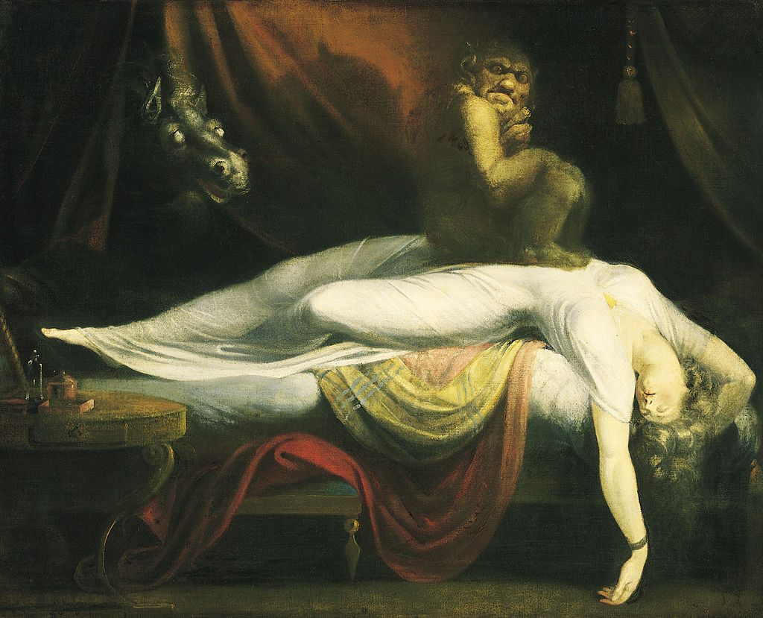

Slide 10
"The Book of the World" William Drummond Of this fair volume which we "World" do name If we the sheets and leaves could turn with care, Of Him who it corrects, and did it frame, We clear might read the art and wisdom rare, Find out His power which wildest powers doth tame, His providence extending everywhere, His justice which proud rebels doth not spare, In every page and period of the same: But silly we, like foolish children, rest Well pleased with coloured vellum, leaves of gold, Fair dangling ribbands, leaving what is best, On the great Writer’s sense ne’er taking hold; Or, if by chance we stay our minds on aught, It is some picture on the margin wrought.

Slide 11
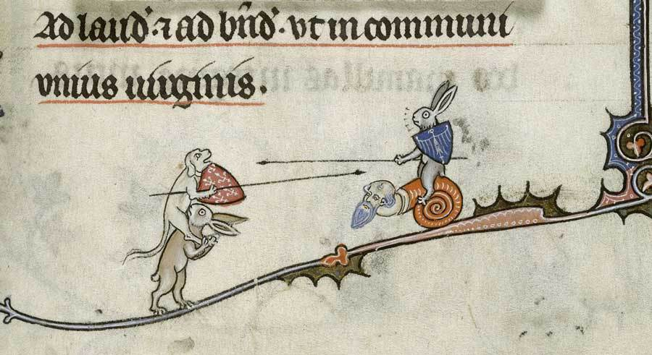

Slide 12
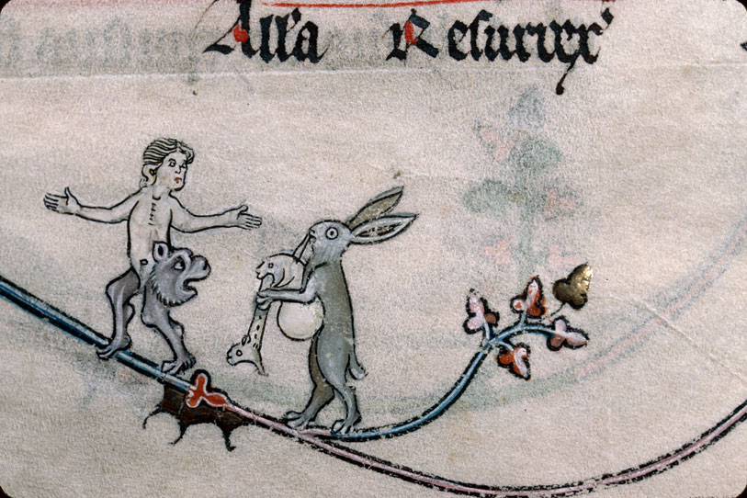

Slide 13
She is called a WEASEL (mustela) as if she were an elongated mouse (mus), for the Greeks say "theon" for "long." When she lives in a house, she moves from place to place with subtle cunning after she has had her babies, and always lies at night in a different lair. She pursues snakes and mice. There are two kinds. One kind keeps far off in the forest -- the Greeks call these Ictides -- and the other wanders about in houses. Some say that they conceive through the ear and give birth through the mouth, while, on the other hand, others declare that they conceive by mouth and give birth by ear. Now these creatures signify not a few of you fellows, who willingly accept by ear the seed of God's word, but who, shackled by the love of earthly things, put it away in the wrong place and dissimulate what you hear. --The Book of Beasts, translated by T. H. White

Slide 15
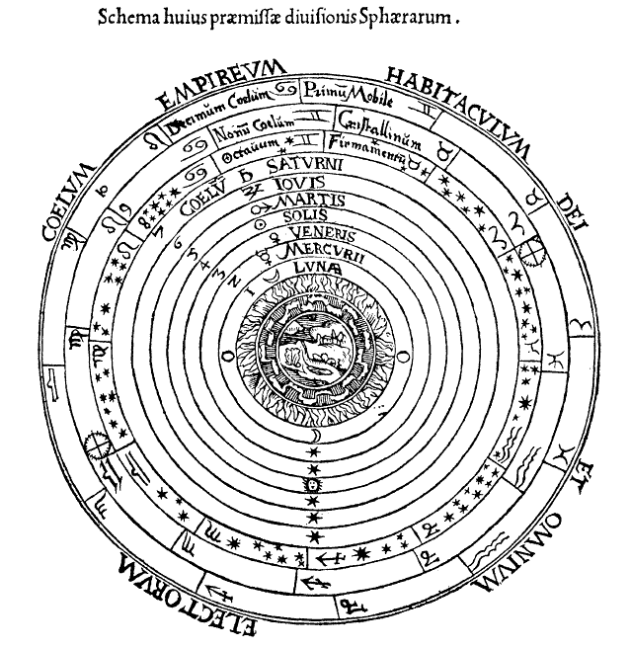

Slide 16
The brain is wider than the sky, For, put them side by side, The one the other will include With ease, and you beside. The brain is deeper than the sea, For, hold them, blue to blue, The one the other will absorb, As sponges, buckets do. The brain is just the weight of God, For, lift them, pound for pound, And they will differ, if they do, As syllable from sound. --Emily Dickinson

